Slide 1
Logical Data Storage

Slide 2
Objective
By the end of this module you will be able to analyze digital evidence using file system functions

Slide 3
Disk Data Structures
Master Boot Record
Partitions
File systems
Host Protected Area
Unpartitioned space

Slide 4


File System
Tool for users to store data within a disk volume in an organized structure of files and directories

Slide 5
File System Tracking
Allocated space – Data clusters that contain active files
Unallocated space – Data clusters that do not contain active files and are ready to contain new files from the file system

Slide 6
Partitions
Collection of consecutive sectors addressable by a single file system contained within that partition
Hard disk can be separated into multiple partitions

Slide 7

Clusters
Smallest data unit to store a file or directory
Rules
Clusters are a fixed size
Only one file can be stored in a cluster
Use as many clusters as needed to store a file
Clusters do not have to be contiguous
picture.jpg
cluster01
cluster02
cluster05
Notes:
Cluster size depends on file system and volume size

Slide 8
Clusters: Example 1
File System
0 | 1 | 2 | 3 | 4 | 5 | 6 | 7
8 | 9 | 10 | 11 | 12 | 13 | 14 | 15

Slide 9
Clusters: Example 2
File System
0 | 1 | 2 | 3 | 4 | 5 | 6 | 7
8 | 9 | 10 | 11 | 12 | 13 | 14 | 15

Slide 10
Slack Space
Sector slack or RAM slack
Data located between the end of the logical file and the end of the last sector of the file
File slack
Data between the last sector of the file and the end of the cluster
Picture.jpg = 900 bytes
File Slack
Sector Slack
Cluster01 = 5Kb

Slide 11
Sector Slack
Bank Account #
RAM
Sector[3]
Cluster[2]

Slide 12
File Slack
myfinances.doc
Sector[3]
Cluster[2]

Slide 13
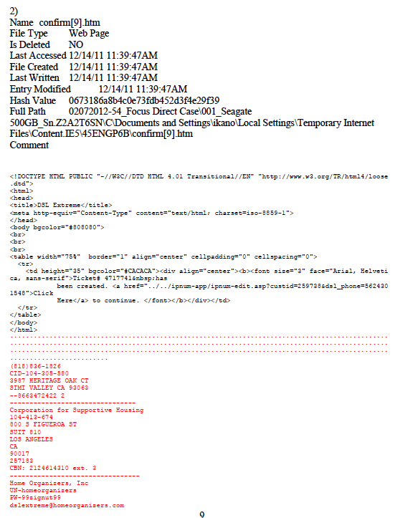
File Slack

Slide 14
File Allocation Table (FAT) System
Supported by most operating systems, such as
Microsoft Windows
UNIX
Linux
OS X
Used in most flash media storage devices

Slide 15
FAT Concepts
Tracks clusters used to store file content
Consists of two main structures
Directory entry
File allocation table
Has three versions (FAT12, FAT16, FAT32)

Slide 16
FAT Data Structures: Directory Entry
Every file and directory has a 32-byte entry
Name of file or directory
Size (bytes)
Beginning cluster address
Metadata
MAC time stamps
picture.jpg
1Mb
Notes:
No file content is stored in the FAT directory entry

Slide 17
FAT Data Structures: File Allocation Table
Tracks status of clusters
Allocated – currently in use by a file
Unallocated – not in use; free to store data
Bad clusters – cannot be used to store data
Tracks location and sequence of clusters used to store file content larger than one cluster
Notes:
Unallocated clusters could contain residual data of evidentiary value that needs to be recovered

Slide 18
FAT Data Structures: Example
Reserved
End-of-File
[0] | [1] | [2] 3 | [3] EOF | [4] 0 | [5] 0 | [6] 0 | [7] 0
[8] 0 | [9] 0 | [10] 0 | [11] 0 | [12] 0 | [13] 0 | [14] 0 | [15] 0
Unallocated
Notes:
Unallocated clusters could contain residual data of evidentiary value that needs to be recovered

Slide 19
Accessing and Retrieving Files
A file is initially accessed using its filename and file path
The file system retrieves the file contents using the starting cluster address and file size until it reaches the EOF marker assigned in FAT

Slide 20
Deleting Files
The file’s directory entry is changed to modify only the first character in its file name to an underscore ( _)
The clusters allocated for the file’s content are marked with zeros

Slide 21
Recovering Deleted Files from FAT
The directory entry still contains information
Deleted files can be fully recovered if stored in
One cluster that was not overwritten, or
Multiple clusters that are
Contiguous
Not allocated to new files

Slide 22
FAT Layout
Reserved area: Volume boot record
File allocation table
Data area
Directory entries
Content of files and directories
Reserved
Area
FAT
Data Area
Volume

Slide 23
New Technology File System (NTFS)
Supported in
Windows NT, 2000, XP, Vista, 7
OS X (read-only)
UNIX/Linux variants (newer kernels)
Successor to FAT
Stronger file access security
Faster performance
More robust

Slide 24
NTFS Concepts
Tracks clusters used to store file content
Is contained in system metadata files stored in the data area of the volume

Slide 25
NTFS System Metadata Files: $Boot
$Boot
Contains the volume boot record
Cluster size
Total number of sectors in the volume
Starting cluster address of $MFT
Location of Boot code (if bootable partition)
Very similar to the FAT VBR

Slide 26
NTFS System Metadata Files: $MFT
$MFT (Master File Table)
Record entry for every file and/or directory in volume
File name
Addresses of all clusters allocated to contain file contents; cluster runs tracked
MAC time stamps; file owner
Small files (<480 bytes) can be stored in MFT record
Notes:
To increase understanding, relate MFT to FAT directory entries

Slide 27
NTFS System Metadata Files: $Bitmap
$Bitmap
Database that keeps track of each cluster in the volume using bits
[0] – cluster is available; unallocated
[1] – cluster is allocated to a file
Cluster runs are not tracked

Slide 28
Summary
You should now be able to
Examine logical data structures
Distinguish characteristics of FAT and NTFS
Identify the file systems used in a storage device
Recover deleted files, folders, and partitions

Slide 29
Thanks!
Any questions?

